Slide 1
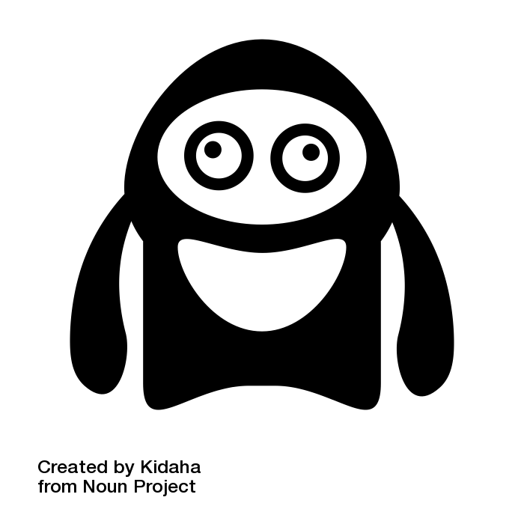
Attribution: Monster by Kidaha from the Noun Project

Slide 2
Hi there !!
Attribution: Monster by Kidaha from the Noun Project

Slide 3
My name is CLIC
Attribution: Monster by Kidaha from the Noun Project

Slide 4
I am the
CXLoyalty Intelligent Concierge
Attribution: Monster by Kidaha from the Noun Project

Slide 5
I in bringing the best experience to our customers.
and I love it !!
Attribution: Monster by Kidaha from the Noun Project

Slide 6
so that none of our customers are left stranded at check-in..
…if the hotel has not received a booking, done on our platform.
In my current version -
I am still learning
directly with the hotel
I re-confirm hotel bookings
and in the future
I could do this in multiple languages !
let me show you how
Attribution: Monster by Kidaha from the Noun Project

Slide 7

Jane, a platinum card holder, has booked a hotel
We want to make sure that Jane does not have an unpleasant surprise when checking in….

Slide 8
Learnings – How was Clic built
Twilio Voice Call Integration
AWS SQS
Dynamo DB
Speech to Text
Robo-calling laws

Slide 9
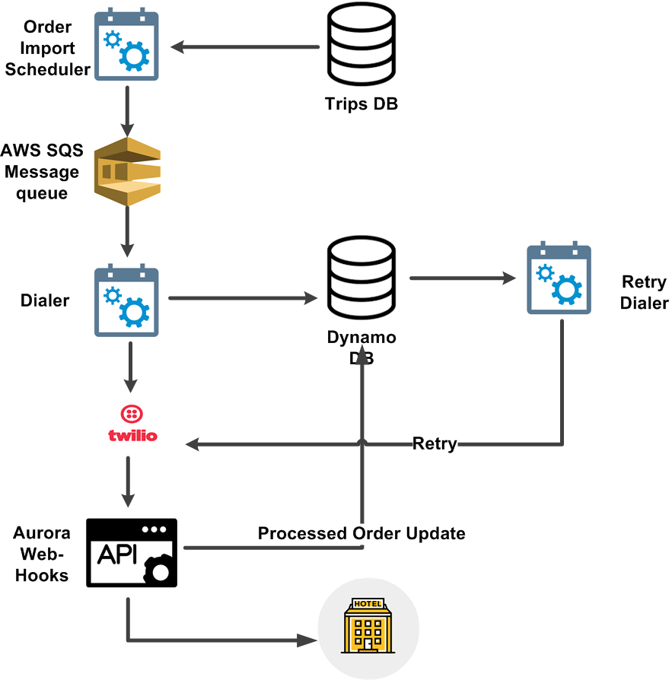
Architecture
Clic is powered by the Aurora Service

Slide 10
Aurora Service
Aurora is set of microservices that can interact with data from trips DB
Queue the data for transmission to third-party systems (Twilio in this version)
Retrieve the data from third party services and store it in an auditable fashion

Slide 11
Future development of Clic
Use AI based speech recognition for more natural conversations.
Use learned speech patterns to extend conversational capacity.

Slide 12
Future functionality of Clic
Ask for preferred rooms and amenities for premium customers.
Converse with hotels to find out ‘on the ground’ amenities and enrich our real-time hotel information.
Assist agents with booking modifications.
Inbound call management to assist agents at peak loads.

